Slide 1
Probability Distribution
Md. Fazlul Karim Patwary
IIT, JU

Slide 2
Probability Distribution
Sample space: All possible outcomes of an experiment comprise a set of outcomes is called sample space
Example: a coin toss 3 times and interest is number of heads then 0, 1, 2, 3 will of interest rather than sample space.

Slide 3
Probability Distribution
Random variable: variable whose value is determined by the outcome of a random experiment.
Discrete random variable: random variable whose set of values assumed is countable.
Continuous random variable: random variable whose set of values assumed is uncountable.

Slide 4
Discrete random variable
Two balls are drawn at random in succession without replacement from an urn containing 4 red balls and 6 black balls. Find the probabilities of all possible outcomes.
Solve:
Let X = # of red balls in the outcome
Possible outcomes: RR RB BR BB
X 2 1 1 0

Slide 5
Discrete random variable
P(RR)=P(R) . P(R) =4/10 . 3/9= 2/15 = P(X=2)
P(X=1)=P(RB)= 4/10 . 6/9 = 4/15
P(X=1)=P(BR)= 6/10 . 4/9 = 4/15
P(X=0)=P(BB)= 6/10 . 5/9 = 1/3
So probability distribution is
X 0 1 2
P(x) 1/3 8/15 2/15
Probability distribution: is a table listing all possible values together with the associated probabilities. The above is discrete probability distribution.
What do you mean by probability distribution?

Slide 6
Continuous random variable
A jar of coffee is picked at random from a filling process in which an automatic machine is filling coffee jars each with 1 kg of coffee. Due to some faults in the automatic process, the weight of a jar could vary from jar to jar in the range 0.9 kg to 1.05 kg.
Let X denote the weight of a jar of coffee selected. What is the range of X?
Ans: Possible outcomes: 0.9<=X< 1.05

Slide 7

Continuous random variable
For continuous random variable the probability distribution is denoted by a function probability density function.
Instead of evaluating the probability of a value it expresses probability of a range of values.
Area under the curve from the range a to b

Slide 8
Expectation and variance of random variable

Slide 9
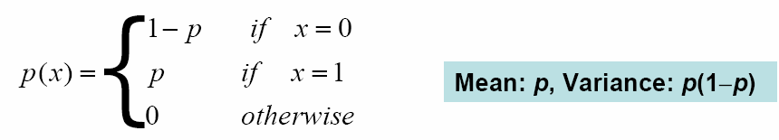
Bernoulli Distribution: Bernoulli (p)
Used to model the distribution with two possible outcomes
E.g. coin flipping
A customer will click a login button or not
A server is up or down
Parameter: p

Slide 10
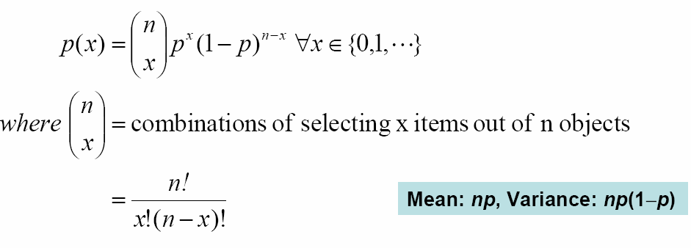
Binomial Distribution: bin(n,p)
Used to model the number of x successes in n Bernoulli trials with probability p of success on each trial
e.g. number of defective items in a batch of size n
no. of packets that reach the destination without loss
Constant probability for each observation
n trials, where x is the number of

Slide 11
Binomial Distribution: bin(n,p)
If Y₁, Y₂, …, Y_{n} are independent Bernoulli(p) random variables, then Y₁+Y₂+…+Y_{n} ~ bin(n, p)
If X₁, X₂, …, X_{n} are independent random variables and
X_{i} ~ bin(t_{i} , p) random variables, then
X₁+X₂+…+X_{n} ~ bin(t₁+t₂+…+t_{n},p)

Slide 12
Binomial Distribution
A binomial experiment is one that possesses the following properties:
The experiment consists of n repeated trials
Each trials results in an outcome that may be classified as a success or a failure.
The probability of a success, denoted by p, remains constant from trial to trial.
Repeated trials are independent

Slide 13
Binomial Distribution
If X is a random variable that possesses values which are the number success in n trials of a binomial experiment, then X is called binomial random variable.
Hence, the probability distribution of X is called binomial probability distribution.
where n=number of trials;
x = # of success = 0,1,2, ….. n
P= probability of success

Slide 14
Binomial Distribution
Mean E(x)=np
Variance Var(x)= np(1-p)

Slide 15
Example: Binomial
A die is tossed 3 times, What is the probability of
No fives turning up?
1 five?
3 fives?

Slide 16




Example: Binomial
This is binomial: 5 or not 5
P(5)=1/6 ; p(not 5)= 5/6; n=3
x=0
x=1
x=2
x=3

Slide 17

Example: Binomial Distribution
Hospital records shows that patient suffering from a diseases and 75% die of it. What is the probability that of 6 randomly selected patients, 4 will recover?
Solve: Here, n=6; x=4 ; p=.25

Slide 18
Example: Binomial Distribution
A manufacturer of meta pistons finds that on the average, 12% of his pistons are rejected because they are either oversize or undersize. What is the probability that a batch of 10 pistons will contain
a) No more than 2 rejects?
b) At least 2 reject?

